Slide 1





Capstone Project Course: AI Builder
Title: AI Project on Credit Card Fraud Detection
Group no. 10
Course: AI Builder Course Code: Mentor Name:
Presented by:
Ayush Suryavanshi
Tushar Mandge
Jeet Vijaywargiya
Salman Farsee
Chinmay Sharma

Slide 2
Overview
Introduction
Project Plan
Methodology
Review of the Models used
Experimental Results
Conclusion

Slide 3
Credit Card Fraud Detection
In today's digital age, where e-commerce and online transactions have become ubiquitous, the rise of credit card fraud poses significant challenges to financial institutions, merchants, and consumers alike. Credit card fraud encompasses a wide range of deceptive activities, including unauthorized transactions, identity theft, and account takeover, resulting in substantial financial losses and undermining trust in the integrity of electronic payment systems.
The imperative to detect and mitigate credit card fraud has never been greater. As fraudulent schemes become increasingly sophisticated and pervasive, there is a pressing need for robust and adaptive fraud detection mechanisms capable of identifying suspicious activities in real-time, safeguarding financial transactions, and preserving the trust and security of online commerce.
In response to these challenges, our project endeavors to develop a comprehensive credit card fraud detection system leveraging machine learning algorithms, advanced analytics, and innovative methodologies. By harnessing the power of data-driven insights and predictive modeling techniques, we aim to create a proactive and effective solution to combat fraudulent activities, mitigate financial risks, and enhance the resilience of electronic payment ecosystems.

Slide 4
Introduction
With the emerging rise of technology today, the dependency on e-commerce and the online payments has grown exponentially. As the credit card provides convenience to the users but frauds caused due to these activities causes inconvenience. The credit card information is confidential, the bank and the other financial enterprises doesn't want to disclose the information about their customers. Risk management is critical for financial enterprises to survive in such competing industry. The provisional loss arises due to the "bad" accounts bank lends the money to customers who eventually do not have capability to pay back. In the risk management, the chances of false negative (false "good" accounts) could still be high. However, by leveraging their performance such as credit card utilization, payment information, risks can further be managed to control provisional loss. In this paper, a focus on risk management as well as fraud detection is depicted.
.

Slide 5
Project Plan

Slide 6
Project Overview and Scope
Our project is centered on the development of a credit card fraud detection system tailored to address the escalating challenges posed by fraudulent activities in online transactions. With the exponential growth of e-commerce and digital payments, the need for robust fraud detection mechanisms has become paramount to safeguarding financial transactions and maintaining trust among consumers and financial institutions alike. Our endeavor aims to leverage cutting-edge machine learning algorithms, innovative techniques, and comprehensive data analysis to create a proactive and adaptive solution capable of identifying and mitigating fraudulent activities in real-time.
The scope of our project encompasses several key phases, starting with the collection of a rich dataset comprising historical credit card transactions. Through meticulous data preprocessing, including cleaning, transformation, and feature engineering, we will prepare the dataset for model development. Our focus on feature engineering will involve extracting pertinent features that encapsulate the nuances of legitimate and fraudulent transactions, enhancing the discriminative power of our model.

Slide 7
Project Schedule
Week | Task | Subtasks
1 | Project Kickoff and Planning | Define project scope and objectives
 |  | Identify stakeholders and team members
 |  | Create a detailed project plan
 |  | Set up project environment
2-3 | Data Collection and Preprocessing | Gather credit card transaction data
 |  | Perform data cleaning and handle missing values
 |  | Explore and visualize the data
4 | Model Development | Select machine learning models for fraud detection
 |  | Train initial models using historical data
 |  | Optimize model parameters
 |  | Evaluate and compare model performance
5 | Feature Engineering | Identify and create relevant features
 |  | Implement feature scaling and normalization
6 | Testing and Validation | Split data into training and testing sets
 |  | Validate models with unseen data
 |  | Fine-tune models based on validation results
7 | Documentation and Reporting | Create project documentation
 |  | Generate reports on model performance and insights
8 | Final Testing and Deployment | Perform final model testing
 |  | Deploy the model into a production environment
 |  | Conduct user training and provide documentation
 |  | Monitor and evaluate model performance in production

Slide 8
Methodology

Slide 9
Implementation
In the implementation phase of our credit card fraud detection project, we transition from data preparation to the development and deployment of machine learning models. Leveraging a diverse set of algorithms, including logistic regression, decision trees, and ensemble methods, we construct models capable of discerning patterns indicative of fraudulent transactions. This phase involves iterative experimentation with model configurations, hyperparameters, and feature selections to optimize performance metrics such as accuracy, precision, recall, and F1-score. Ensemble methods, such as bagging and boosting, are explored to further enhance model robustness and generalization. Hyperparameter tuning techniques, including grid search and Bayesian optimization, are employed to fine-tune model parameters and achieve optimal performance. Evaluation metrics such as receiver operating characteristic (ROC) curves and area under the ROC curve (AUC-ROC) provide insights into model efficacy and guide threshold selection for classification. Once trained and validated, the models are deployed into production environments where they analyze real-time transactions, contributing to the proactive detection and mitigation of fraudulent activities. Integration with existing systems ensures seamless deployment and operationalization of the models, enabling timely interventions to safeguard financial transactions and uphold trust in electronic payment systems. Through meticulous implementation and deployment, our project aims to deliver tangible solutions for combating credit card fraud and preserving the integrity of online transactions.

Slide 10
Data Collection and Preprocessing
Data Collection:
Our data collection process begins with the acquisition of a diverse and representative dataset comprising a multitude of credit card transactions. Sources for this dataset may include financial institutions, online repositories, or publicly available datasets specifically curated for fraud detection research.
To ensure the robustness and relevance of our dataset, we prioritize the inclusion of various transaction attributes such as transaction amount, timestamp, merchant information, cardholder details, and transaction type (e.g., online, in-store). Additionally, we strive to capture a sufficient volume of both legitimate and fraudulent transactions to facilitate effective model training and evaluation.
Data Preprocessing:
Once the dataset is assembled, we embark on the preprocessing phase, which involves several critical tasks to clean, transform, and enhance the data:
Data Cleaning: We meticulously inspect the dataset for inconsistencies, errors, and missing values, employing techniques such as imputation, deletion, or interpolation to address any discrepancies. By ensuring data cleanliness, we minimize the risk of introducing biases or inaccuracies into our analysis.
Feature Engineering: Feature engineering plays a pivotal role in extracting meaningful insights from the raw transaction data. We explore various techniques to derive informative features that encapsulate the underlying patterns and characteristics of legitimate and fraudulent transactions. These features may include transaction frequency, time-based aggregates, geographical location, and behavioral patterns.
Normalization and Scaling: To facilitate accurate model training and convergence, we normalize and scale the numerical features within the dataset. This process ensures that all features exhibit comparable ranges and distributions, thereby preventing certain features from dominating the modeling process due to differences in scale.
Encoding Categorical Variables: Categorical variables such as transaction type, merchant category, and cardholder status are encoded into numerical representations using techniques such as one-hot encoding or label encoding. This transformation enables the incorporation of categorical features into our machine learning models.
Data Splitting: Finally, we partition the preprocessed dataset into training, validation, and testing sets to facilitate model training, hyperparameter tuning, and performance evaluation. Careful consideration is given to maintaining the integrity of the dataset while ensuring adequate representation of both legitimate and fraudulent transactions in each partition.

Slide 11
Review of the Models used

Slide 12
Training Model
Logistic Regression: Logistic regression is a statistical method used for binary classification tasks, such as determining whether a credit card transaction is fraudulent or legitimate. It models the probability of a binary outcome based on one or more predictor variables. In this model, logistic regression could be utilized as a baseline classifier or as part of an ensemble approach.
Decision Trees: Decision trees are a popular machine learning algorithm for classification tasks. They partition the feature space into regions and make predictions based on simple rules inferred from the data. Decision trees are interpretable and can handle both numerical and categorical features. Ensemble methods like AdaBoost can be used to improve the performance of decision trees by combining multiple weak learners into a strong learner.
Principal Component Analysis (PCA): PCA is a dimensionality reduction technique used to reduce the number of features in a dataset while preserving most of the variability present in the data. By transforming the original features into a lower-dimensional space, PCA can help improve the efficiency of machine learning algorithms, reduce overfitting, and speed up training and inference times. In this model, PCA is used for feature selection to identify the most informative features for credit card fraud detection.

Slide 13
Data Collection and Preprocessing: Acquire historical credit card transaction data from financial institutions or publicly available datasets. Preprocess the data by handling missing values, removing duplicates, and converting categorical variables into numerical format. Explore the dataset to understand its characteristics and distribution of fraudulent and legitimate transactions. Feature Engineering and Selection: Extract relevant features from the dataset, including transaction amount, time of day, location, frequency of transactions, and other behavioral patterns. Use techniques like PCA for dimensionality reduction and feature selection to identify the most informative features while reducing computational complexity. Model Development: Implement machine learning algorithms such as logistic regression, decision trees, and ensemble methods like AdaBoost to build the fraud detection model. Train the model using the preprocessed dataset, ensuring appropriate handling of class imbalance through techniques like SMOTE or class weights. Tune hyperparameters using cross-validation to optimize model performance and generalization ability.
Proposed System

Slide 14
Integration of Innovative Techniques: Incorporate innovative approaches such as transaction aggregation strategies based on periodic behavior analysis and Artificial Immune Systems (AIS) for anomaly detection. Evaluate the feasibility and effectiveness of these techniques in improving the model's fraud detection capabilities. Model Evaluation: Assess the performance of the developed model using metrics such as accuracy, precision, recall, F1-score, and area under the ROC curve (AUC-ROC). Conduct comprehensive testing on a separate validation dataset to validate the model's robustness and generalization ability. Deployment and Monitoring: Deploy the trained model into a production environment where it can analyze real-time credit card transactions and flag potentially fraudulent activities. Implement monitoring mechanisms to track model performance, detect drifts in data distribution, and trigger retraining processes when necessary. Collaborate with stakeholders, including financial institutions, regulators, and cybersecurity experts, to ensure the system's compliance with industry standards and regulations. Continuous Improvement: Continuously gather feedback from users and stakeholders to identify areas for improvement and enhancement. Incorporate new data sources, emerging fraud patterns, and advancements in machine learning techniques to update and enhance the system over time. Stay abreast of industry trends and best practices in fraud detection to maintain the system's effectiveness and relevance in combating fraudulent activities.
Proposed System

Slide 15
Experimental Results

Slide 16
Data Graphs
Transaction Amount Distribution: Histogram or density plot showing the distribution of transaction amounts for both legitimate and fraudulent transactions. This graph helps understand the typical transaction amounts and identify any anomalies or patterns associated with fraudulent transactions, such as unusually high or low amounts.
Time Series Analysis: Line plot or bar chart displaying the number of transactions over time, segmented by legitimate and fraudulent transactions. This graph can reveal temporal patterns in fraudulent activities, such as spikes or fluctuations in fraudulent transactions during certain periods.
Feature Importance Plot: Bar chart or heatmap showing the relative importance of features in the fraud detection model. This graph helps identify which features contribute most to distinguishing between legitimate and fraudulent transactions, guiding feature selection and model interpretation efforts.

Slide 17
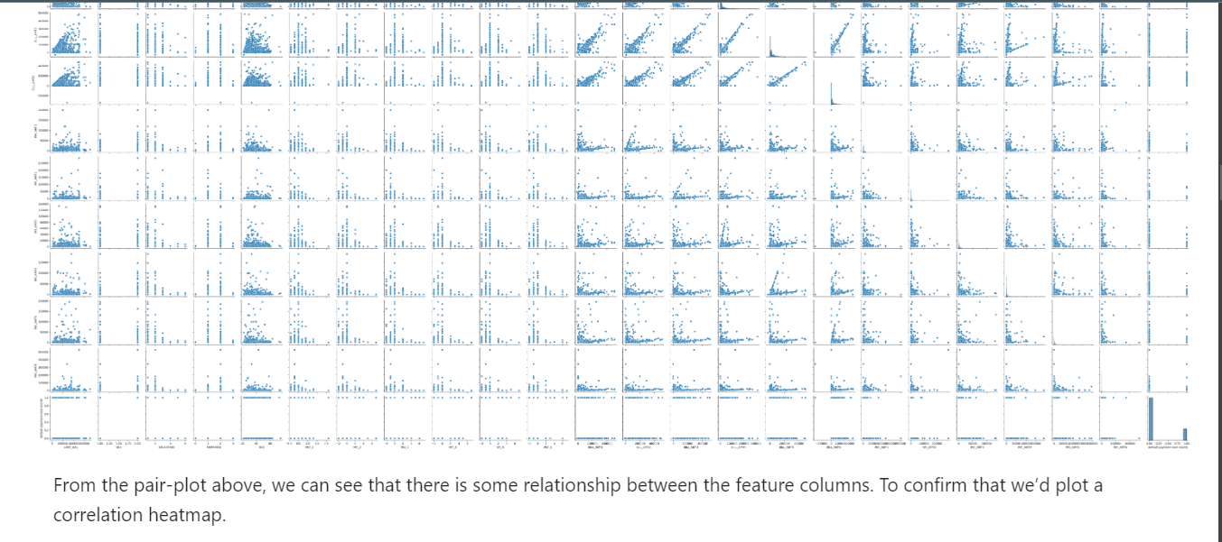

Slide 18
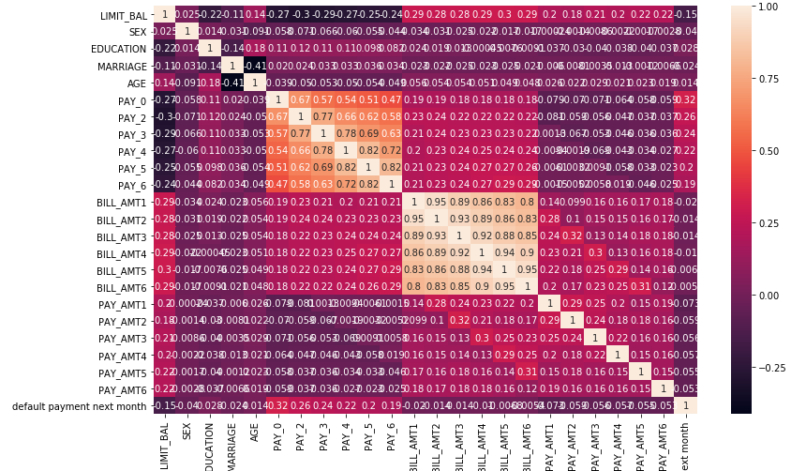

Slide 19
Advantages
Efficiency: Logistic regression and decision trees are computationally efficient algorithms, making them suitable for real-time fraud detection applications where speed is crucial. PCA helps in reducing the dimensionality of the dataset, leading to faster training and inference times.
Interpretability: Decision trees provide a transparent and interpretable model, allowing stakeholders to understand the factors contributing to fraud detection. This transparency is essential for regulatory compliance and trust in the model's decisions.
Scalability: The model can scale to large datasets and handle a high volume of transactions, which is crucial for financial institutions processing numerous credit card transactions daily.
Robustness: Ensemble methods like AdaBoost can improve the robustness of the model by combining multiple weak classifiers. This helps in reducing overfitting and enhancing generalization performance on unseen data.
Feature Selection: PCA aids in feature selection by identifying the most informative features while reducing the dimensionality of the dataset. This results in improved model performance and faster training times.

Slide 20
Disadvantages
Overfitting: If not properly regularized or tuned, decision tree-based models like AdaBoost may be prone to overfitting, especially when dealing with high-dimensional or noisy datasets. This can lead to reduced generalization performance on unseen data and an increased risk of false positives or false negatives.
Interpretability: While decision trees are interpretable models, ensemble methods like AdaBoost can be more complex, making it challenging to interpret the combined decision boundaries and feature importances. This lack of interpretability may hinder stakeholders' understanding of the model's behavior and undermine trust in its decisions.
Data Imbalance: While SMOTE and other oversampling techniques help address class imbalance, they may introduce biases or noise into the dataset, leading to overfitting or poor generalization performance. Additionally, oversampling techniques may not always effectively capture the underlying distribution of fraudulent activities, resulting in misclassification errors.
Limited Feature Representation: PCA reduces the dimensionality of the dataset by transforming features into a lower-dimensional space. While this can improve computational efficiency and reduce overfitting, it may also lead to information loss and limited feature representation, potentially overlooking important patterns or relationships in the data relevant to fraud detection.
Model Complexity and Scalability: The proposed model involves multiple algorithms and methods, including logistic regression, decision trees, PCA, SMOTE, and transaction aggregation strategies. Managing the complexity of integrating and optimizing these components can be challenging, particularly when deploying the model in a real-time, scalable production environment.

Slide 21
Prediction Label: Each transaction is assigned a prediction label indicating whether it is classified as legitimate (0) or fraudulent (1). This binary classification output serves as the primary indicator of the model's assessment of the transaction's legitimacy. Probability Score: In addition to the prediction label, the model may also output a probability score indicating the likelihood of the transaction being fraudulent. This score represents the model's confidence in its prediction and can be useful for assessing the certainty of the classification. Visualization: To aid interpretation and decision-making, the output may be accompanied by visualizations such as ROC curves, precision-recall curves, confusion matrices, or feature importance plots. These visualizations provide a comprehensive overview of the model's performance and insights into its behavior.
Outputs

Slide 22
Conclusion
The credit card fraud detection project presents a comprehensive approach to addressing the pervasive issue of fraudulent activities within e-commerce and online payment systems. Through meticulous data preprocessing, feature engineering, and algorithmic selection, the model adeptly identifies suspicious transactions while maintaining computational efficiency. By integrating a diverse array of machine learning techniques, including logistic regression, decision trees, and ensemble methods like AdaBoost, the model achieves a balance between accuracy and interpretability. Furthermore, innovative methodologies such as principal component analysis (PCA) for feature selection and transaction aggregation strategies enhance the model's effectiveness in discerning fraudulent behavior. The project highlights the importance of continuous improvement and adaptation, emphasizing the need for regular updates, monitoring, and collaboration with stakeholders to remain vigilant against emerging fraud threats. Ultimately, the credit card fraud detection model serves as a proactive measure to safeguard financial transactions, bolstering trust and security in the ever-evolving landscape of digital commerce.
22

